Slide 1
CS107, Lecture 3 Bits and Bytes; Bitwise Operators
reading:
Bryant & O’Hallaron, Ch. 2.1

Slide 2
Plan For Today
Recap: Integer Representations
Truncating and Expanding
Bitwise Operators and Masks
Demo 1: Courses
Break: Announcements
Demo 2: Powers of 2
Bit Shift Operators

Slide 3
Plan For Today
Recap: Integer Representations
Truncating and Expanding
Bitwise Operators and Masks
Demo 1: Courses
Break: Announcements
Demo 2: Powers of 2
Bit Shift Operators

Slide 4
Base 2
1 0 1 1
2³
2²
2¹
2⁰

Slide 5
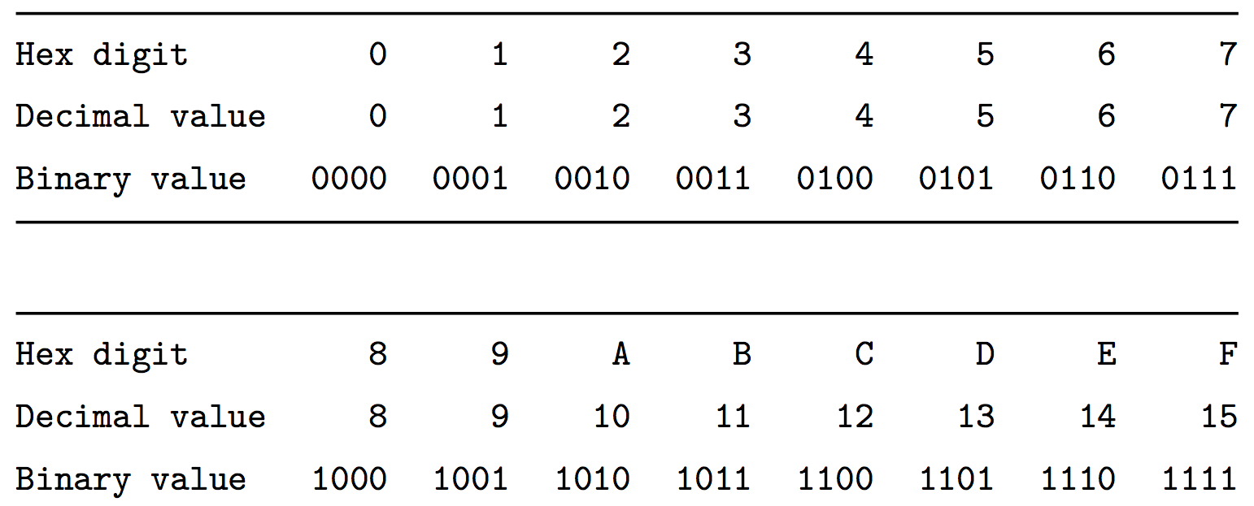
Hexadecimal

Slide 6
Unsigned Integers

Slide 7
Signed Integers: Two’s Complement
In two’s complement, we represent a positive number as itself, and its negative equivalent as the two’s complement of itself.
The two’s complement of a number is the binary digits inverted, plus 1.
This works to convert from positive to negative, and back from negative to positive!
Notes:
Example here with 4 bits, but this is system for e.g. 32 bit ints!

Slide 8
Signed Integers: Two’s Complement
Con: more difficult to represent, and difficult to convert to/from decimal and between positive and negative.
Pro: only 1 representation for 0!
Pro: all bits are used to represent as many numbers as possible
Pro: it turns out that the most significant bit still indicates the sign of a number.
Pro: arithmetic is easy: we just add!

Slide 9
Overflow and Underflow
If you exceed the maximum value of your bit representation, you wrap around or overflow back to the smallest bit representation.
0b1111 + 0b1 = 0b0000
If you go below the minimum value of your bit representation, you wrap around or underflow back to the largest bit representation.
0b0000 - 0b1 = 0b1111
Notes:
Technically overflowing with signed integers in C is undefined. But it is predictable

Slide 10
Unsigned Integers
≈+4billion
0
111…111
000…000
111…110
000…001
111…101
000…010
111…100
Discontinuity means overflow possible here
000…011
More increasing positive numbers
…
Increasing positive numbers
…
100…010
011…101
100…001
011…110
100…000
011…111

Slide 11
Signed Numbers
-1
0
+1
111…111
000…000
111…110
000…001
111…101
000…010
111…100
000…011
Negative numbers becoming less negative
(i.e. increasing)
Increasing positive numbers
…
…
Discontinuity means overflow possible here
100…010
011…101
100…001
011…110
100…000
011…111
≈+2billion
≈-2billion

Slide 12
Aside: ASCII
ASCII is an encoding from common characters (letters, symbols, etc.) to bit representations (chars).
E.g. 'A’ is 0x41
Neat property: all uppercase letters, and all lowercase letters, are sequentially represented!
E.g. 'B’ is 0x42
Notes:
CHARS ARE SIGNED

Slide 13
printf and Integers
There are 3 placeholders for 32-bit integers that we can use:
%d: signed 32-bit int
%u: unsigned 32-bit int
%x: hex 32-bit int
As long as the value is a 32-bit type, printf will treat it according to the placeholder!

Slide 14
Casting
What happens at the byte level when we cast between variable types? The bytes remain the same! This means they may be interpreted differently depending on the type.
int v = -12345;
unsigned int uv = v;
printf("v = %d, uv = %u\n", v, uv);
This prints out: "v = -12345, uv = 4294954951". Why?

Slide 15
Casting
What happens at the byte level when we cast between variable types? The bytes remain the same! This means they may be interpreted differently depending on the type.
int v = -12345;
unsigned int uv = v;
printf("v = %d, uv = %u\n", v, uv);
-12345 in binary is 1111 1111 1111 1111 1100 1111 1100 0111.
If we treat this binary representation as a positive number, it’s huge!

Slide 16
Casting
Notes:
SECURITY CONCERNS! Left side means different things

Slide 17
Comparisons Between Different Types
Be careful when comparing signed and unsigned integers. C will implicitly cast the signed argument to unsigned, and then performs the operation assuming both numbers are non-negative.
Expression | Type | Evaluation | Correct?
0 == 0U
-1 < 0
-1 < 0U
2147483647 > -2147483647 - 1
2147483647U > -2147483647 - 1
2147483647 > (int)2147483648U
-1 > -2
(unsigned)-1 > -2
Notes:
ONLY CASTS FOR DIFFERENT TYPES

Slide 18
Comparisons Between Different Types
Be careful when comparing signed and unsigned integers. C will implicitly cast the signed argument to unsigned, and then performs the operation assuming both numbers are non-negative.
Expression | Type | Evaluation | Correct?
0 == 0U | Unsigned | true | yes
-1 < 0
-1 < 0U
2147483647 > -2147483647 - 1
2147483647U > -2147483647 - 1
2147483647 > (int)2147483648U
-1 > -2
(unsigned)-1 > -2
Notes:
ONLY CASTS FOR DIFFERENT TYPES

Slide 19
Comparisons Between Different Types
Be careful when comparing signed and unsigned integers. C will implicitly cast the signed argument to unsigned, and then performs the operation assuming both numbers are non-negative.
Expression | Type | Evaluation | Correct?
0 == 0U | Unsigned | true | yes
-1 < 0 | Signed | true | yes
-1 < 0U
2147483647 > -2147483647 - 1
2147483647U > -2147483647 - 1
2147483647 > (int)2147483648U
-1 > -2
(unsigned)-1 > -2
Notes:
ONLY CASTS FOR DIFFERENT TYPES

Slide 20
Comparisons Between Different Types
Be careful when comparing signed and unsigned integers. C will implicitly cast the signed argument to unsigned, and then performs the operation assuming both numbers are non-negative.
Expression | Type | Evaluation | Correct?
0 == 0U | Unsigned | true | yes
-1 < 0 | Signed | true | yes
-1 < 0U | Unsigned | false | no!
2147483647 > -2147483647 - 1
2147483647U > -2147483647 - 1
2147483647 > (int)2147483648U
-1 > -2
(unsigned)-1 > -2
Notes:
ONLY CASTS FOR DIFFERENT TYPES

Slide 21
Comparisons Between Different Types
Be careful when comparing signed and unsigned integers. C will implicitly cast the signed argument to unsigned, and then performs the operation assuming both numbers are non-negative.
Expression | Type | Evaluation | Correct?
0 == 0U | Unsigned | true | yes
-1 < 0 | Signed | true | yes
-1 < 0U | Unsigned | false | no!
2147483647 > -2147483647 - 1 | Signed | true | yes
2147483647U > -2147483647 - 1
2147483647 > (int)2147483648U
-1 > -2
(unsigned)-1 > -2
Notes:
ONLY CASTS FOR DIFFERENT TYPES

Slide 22
Comparisons Between Different Types
Be careful when comparing signed and unsigned integers. C will implicitly cast the signed argument to unsigned, and then performs the operation assuming both numbers are non-negative.
Expression | Type | Evaluation | Correct?
0 == 0U | Unsigned | true | yes
-1 < 0 | Signed | true | yes
-1 < 0U | Unsigned | false | no!
2147483647 > -2147483647 - 1 | Signed | true | yes
2147483647U > -2147483647 - 1 | Unsigned | false | no!
2147483647 > (int)2147483648U
-1 > -2
(unsigned)-1 > -2
Notes:
ONLY CASTS FOR DIFFERENT TYPES

Slide 23
Comparisons Between Different Types
Be careful when comparing signed and unsigned integers. C will implicitly cast the signed argument to unsigned, and then performs the operation assuming both numbers are non-negative.
Expression | Type | Evaluation | Correct?
0 == 0U | Unsigned | true | yes
-1 < 0 | Signed | true | yes
-1 < 0U | Unsigned | false | no!
2147483647 > -2147483647 - 1 | Signed | true | yes
2147483647U > -2147483647 - 1 | Unsigned | false | no!
2147483647 > (int)2147483648U | Signed | true | no!
-1 > -2
(unsigned)-1 > -2
Notes:
ONLY CASTS FOR DIFFERENT TYPES

Slide 24
Comparisons Between Different Types
Be careful when comparing signed and unsigned integers. C will implicitly cast the signed argument to unsigned, and then performs the operation assuming both numbers are non-negative.
Expression | Type | Evaluation | Correct?
0 == 0U | Unsigned | true | yes
-1 < 0 | Signed | true | yes
-1 < 0U | Unsigned | false | no!
2147483647 > -2147483647 - 1 | Signed | true | yes
2147483647U > -2147483647 - 1 | Unsigned | false | no!
2147483647 > (int)2147483648U | Signed | true | no!
-1 > -2 | Signed | true | yes
(unsigned)-1 > -2
Notes:
ONLY CASTS FOR DIFFERENT TYPES

Slide 25
Comparisons Between Different Types
Be careful when comparing signed and unsigned integers. C will implicitly cast the signed argument to unsigned, and then performs the operation assuming both numbers are non-negative.
Expression | Type | Evaluation | Correct?
0 == 0U | Unsigned | true | yes
-1 < 0 | Signed | true | yes
-1 < 0U | Unsigned | false | no!
2147483647 > -2147483647 - 1 | Signed | true | yes
2147483647U > -2147483647 - 1 | Unsigned | false | no!
2147483647 > (int)2147483648U | Signed | true | no!
-1 > -2 | Signed | true | yes
(unsigned)-1 > -2 | Unsigned | true | yes
Notes:
ONLY CASTS FOR DIFFERENT TYPES

Slide 26
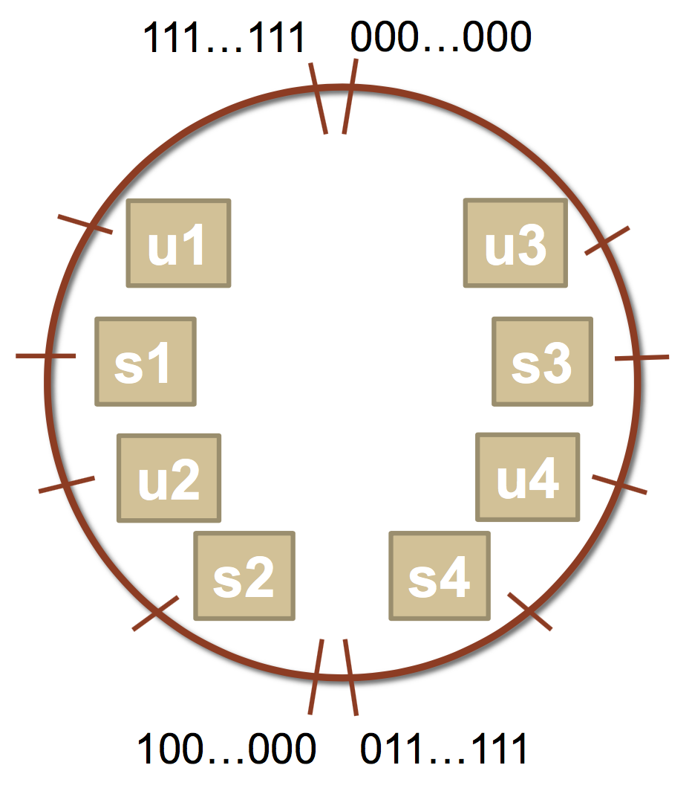
Comparisons Between Different Types
Which of the following statements are true? (assume that
variables are set to values that place them in the spots shown)
1. s3 > u3
2. u2 > u4
3. s2 > s4
4. s1 > s2
5. u1 > u2
6. s1 > u3
Notes:
**True
True
False
True
True
**true

Slide 27
Comparisons Between Different Types
Which of the following statements are true? (assume that
variables are set to values that place them in the spots shown)
1. s3 > u3 - true
2. u2 > u4
3. s2 > s4
4. s1 > s2
5. u1 > u2
6. s1 > u3
Notes:
**True
True
False
True
True
**true

Slide 28
Comparisons Between Different Types
Which of the following statements are true? (assume that
variables are set to values that place them in the spots shown)
1. s3 > u3 - true
2. u2 > u4 - true
3. s2 > s4
4. s1 > s2
5. u1 > u2
6. s1 > u3
Notes:
**True
True
False
True
True
**true

Slide 29
Comparisons Between Different Types
Which of the following statements are true? (assume that
variables are set to values that place them in the spots shown)
1. s3 > u3 - true
2. u2 > u4 - true
3. s2 > s4 - false
4. s1 > s2
5. u1 > u2
6. s1 > u3
Notes:
**True
True
False
True
True
**true

Slide 30
Comparisons Between Different Types
Which of the following statements are true? (assume that
variables are set to values that place them in the spots shown)
1. s3 > u3 - true
2. u2 > u4 - true
3. s2 > s4 - false
4. s1 > s2 - true
5. u1 > u2
6. s1 > u3
Notes:
**True
True
False
True
True
**true

Slide 31
Comparisons Between Different Types
Which of the following statements are true? (assume that
variables are set to values that place them in the spots shown)
1. s3 > u3 - true
2. u2 > u4 - true
3. s2 > s4 - false
4. s1 > s2 - true
5. u1 > u2 - true
6. s1 > u3
Notes:
**True
True
False
True
True
**true

Slide 32
Comparisons Between Different Types
Which of the following statements are true? (assume that
variables are set to values that place them in the spots shown)
1. s3 > u3 - true
2. u2 > u4 - true
3. s2 > s4 - false
4. s1 > s2 - true
5. u1 > u2 - true
6. s1 > u3 - true
Notes:
**True
True
False
True
True
**true

Slide 33
Plan For Today
Recap: Integer Representations
Truncating and Expanding
Bitwise Operators and Masks
Demo 1: Courses
Break: Announcements
Demo 2: Powers of 2
Bit Shift Operators

Slide 34
Expanding Bit Representations
Sometimes, we want to convert between two integers of different sizes (e.g. short to int, or int to long).
We might not be able to convert from a bigger data type to a smaller data type, but we do want to always be able to convert from a smaller data type to a bigger data type.
For unsigned values, we can add leading zeros to the representation (“zero extension”)
For signed values, we can repeat the sign of the value for new digits (“sign extension”
Note: when doing <, >, <=, >= comparison between different size types, it will promote to the larger type.

Slide 35
Expanding Bit Representation
unsigned short s = 32772;
// short is a 16-bit format, so s = 1000 0000 0000 0100b
unsigned int i = s;
// conversion to 32-bit int, so i = 0000 0000 0000 0000 1000 0000 0000 0100b

Slide 36
Expanding Bit Representation
unsigned short s = 32772;
// short is a 16-bit format, so s = 1000 0000 0000 0100b
unsigned int i = s;
// conversion to 32-bit int, so i = 0000 0000 0000 0000 1000 0000 0000 0100b
— or —
short s = -4;
// short is a 16-bit format, so s = 1111 1111 1111 1100b
int i = s;
// conversion to 32-bit int, so i = 1111 1111 1111 1111 1111 1111 1111 1100b

Slide 37
Truncating Bit Representation
If we want to reduce the bit size of a number, C truncates the representation and discards the more significant bits.
What happens here? Let's look at the bits in x (a 32-bit int), 53191:
0000 0000 0000 0000 1100 1111 1100 0111
When we cast x to a short, it only has 16-bits, and C truncates the number:
1100 1111 1100 0111
This is -12345! And when we cast sx back an int, we sign-extend the number.
1111 1111 1111 1111 1100 1111 1100 0111 // still -12345
int x = 53191;
short sx = x;
int y = sx;

Slide 38
Truncating Bit Representation
If we want to reduce the bit size of a number, C truncates the representation and discards the more significant bits.
What happens here? Let's look at the bits in x (a 32-bit int), -3:
1111 1111 1111 1111 1111 1111 1111 1101
When we cast x to a short, it only has 16-bits, and C truncates the number:
1111 1111 1111 1101
This is -3! If the number does fit, it will convert fine. y looks like this:
1111 1111 1111 1111 1111 1111 1111 1101 // still -3
int x = -3;
short sx = x;
int y = sx;

Slide 39
Truncating Bit Representation
If we want to reduce the bit size of a number, C truncates the representation and discards the more significant bits.
What happens here? Let's look at the bits in x (a 32-bit unsigned int), 128000:
0000 0000 0000 0001 1111 0100 0000 0000
When we cast x to a short, it only has 16-bits, and C truncates the number:
1111 0100 0000 0000
This is 62464! Unsigned numbers can lose info too. Here is what y looks like:
0000 0000 0000 0000 1111 0100 0000 0000 // still 62464
unsigned int x = 128000;
unsigned short sx = x;
unsigned int y = sx;

Slide 40
sizeof
sizeof takes a variable type as a parameter and returns its size in bytes.
sizeof(type)
For example:
sizeof(char) => 1
sizeof(short) => 2
sizeof(int) => 4
sizeof(unsigned int) => 4
sizeof(long) => 8
sizeof(char *) => 8

Slide 41
Now that we understand binary representations, how can we manipulate them at the bit level?

Slide 42
Plan For Today
Recap: Integer Representations
Truncating and Expanding
Bitwise Operators and Masks
Demo 1: Courses
Break: Announcements
Demo 2: Powers of 2
Bit Shift Operators

Slide 43
Bitwise Operators
You’re already familiar with many operators in C:
Arithmetic operators: +, -, *, /, %
Comparison operators: ==, !=, <, >, <=, >=
Logical Operators: &&, ||, !
Today, we’re introducing a new category of operators: bitwise operators:
&, |, ~, ^, <<, >>

Slide 44
And (&)
AND is a binary operator. The AND of 2 bits is 1 if both bits are 1, and 0 otherwise.
output = a & b;
a | b | output
0 | 0 | 0
0 | 1 | 0
1 | 0 | 0
1 | 1 | 1

Slide 45
Or (|)
OR is a binary operator. The OR of 2 bits is 1 if either (or both) bits is 1.
output = a | b;
a | b | output
0 | 0 | 0
0 | 1 | 1
1 | 0 | 1
1 | 1 | 1

Slide 46
Not (~)
NOT is a unary operator. The NOT of a bit is 1 if the bit is 0, or 1 otherwise.
output = ~a;
a | output
0 | 1
1 | 0

Slide 47
Exclusive Or (^)
Exclusive Or (XOR) is a binary operator. The XOR of 2 bits is 1 if exactly one of the bits is 1, or 0 otherwise.
output = a ^ b;
a | b | output
0 | 0 | 0
0 | 1 | 1
1 | 0 | 1
1 | 1 | 0

Slide 48
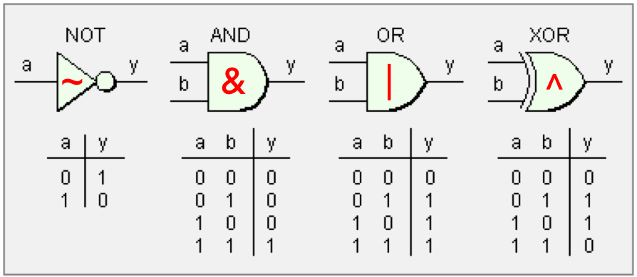
An Aside: Boolean Algebra
These operators are not unique to computers; they are part of a general area called Boolean Algebra. These are applicable in math, hardware, computers, and more!

Slide 49
Operators on Multiple Bits
When these operators are applied to numbers (multiple bits), the operator is applied to the corresponding bits in each number. For example:
AND
OR
XOR
NOT
0110
& 1100
----
0100
0110
| 1100
----
1110
0110
^ 1100
----
1010
~ 1100
----
0011
Note: these are different from the logical operators AND (&&), OR (||) and NOT (!).

Slide 50
Operators on Multiple Bits
When these operators are applied to numbers (multiple bits), the operator is applied to the corresponding bits in each number. For example:
AND
OR
XOR
NOT
0110
& 1100
----
0100
0110
| 1100
----
1110
0110
^ 1100
----
1010
~ 1100
----
0011
This is different from logical AND (&&). The logical AND returns true if both are nonzero, or false otherwise.

Slide 51
Operators on Multiple Bits
When these operators are applied to numbers (multiple bits), the operator is applied to the corresponding bits in each number. For example:
AND
OR
XOR
NOT
0110
& 1100
----
0100
0110
| 1100
----
1110
0110
^ 1100
----
1010
~ 1100
----
0011
This is different from logical NOT (!). The logical NOT returns true if this is zero, and false otherwise.

Slide 52
Bit Vectors and Sets
We can use bit vectors (ordered collections of bits) to represent finite sets, and perform functions such as union, intersection, and complement.
Example: we can represent current courses taken using a char.
0 | 0 | 1 | 0 | 0 | 0 | 1 | 1
CS161
CS109
CS103
CS110
CS107
CS106X
CS106B
CS106A

Slide 53
Bit Vectors and Sets
0 | 0 | 1 | 0 | 0 | 0 | 1 | 1
CS161
CS109
CS103
CS110
CS107
CS106X
CS106B
CS106A
How do we find the union of two sets of courses taken? Use OR:
00100011
| 01100001
--------
01100011

Slide 54
Bit Vectors and Sets
0 | 0 | 1 | 0 | 0 | 0 | 1 | 1
CS161
CS109
CS103
CS110
CS107
CS106X
CS106B
CS106A
How do we find the intersection of two sets of courses taken? Use AND:
00100011
& 01100001
--------
00100001

Slide 55
Bit Masking
We will frequently want to manipulate or isolate out specific bits in a larger collection of bits. A bitmask is a constructed bit pattern that we can use, along with bit operators, to do this.
Example: how do we update our bit vector to indicate we’ve taken CS107?
0 | 0 | 1 | 0 | 0 | 0 | 1 | 1
CS161
CS109
CS103
CS110
CS107
CS106X
CS106B
CS106A
00100011
| 00001000
--------
00101011

Slide 56
Bit Masking
#define CS106A 0x1 /* 0000 0001 */
#define CS106B 0x2 /* 0000 0010 */
#define CS106X 0x4 /* 0000 0100 */
#define CS107 0x8 /* 0000 1000 */
#define CS110 0x10 /* 0001 0000 */
#define CS103 0x20 /* 0010 0000 */
#define CS109 0x40 /* 0100 0000 */
#define CS161 0x80 /* 1000 0000 */
char myClasses = ...;
myClasses = myClasses | CS107; // Add CS107

Slide 57
Bit Masking
#define CS106A 0x1 /* 0000 0001 */
#define CS106B 0x2 /* 0000 0010 */
#define CS106X 0x4 /* 0000 0100 */
#define CS107 0x8 /* 0000 1000 */
#define CS110 0x10 /* 0001 0000 */
#define CS103 0x20 /* 0010 0000 */
#define CS109 0x40 /* 0100 0000 */
#define CS161 0x80 /* 1000 0000 */
char myClasses = ...;
myClasses |= CS107; // Add CS107

Slide 58
Bit Masking
Example: how do we update our bit vector to indicate we’ve not taken CS103?
0 | 0 | 1 | 0 | 0 | 0 | 1 | 1
CS161
CS109
CS103
CS110
CS107
CS106X
CS106B
CS106A
00100011
& 11011111
--------
00000011
char myClasses = ...;
myClasses = myClasses & ~CS103; // Remove CS103

Slide 59
Bit Masking
Example: how do we update our bit vector to indicate we’ve not taken CS103?
0 | 0 | 1 | 0 | 0 | 0 | 1 | 1
CS161
CS109
CS103
CS110
CS107
CS106X
CS106B
CS106A
00100011
& 11011111
--------
00000011
char myClasses = ...;
myClasses &= ~CS103; // Remove CS103

Slide 60
Bit Masking
Example: how do we check if we’ve taken CS106B?
0 | 0 | 1 | 0 | 0 | 0 | 1 | 1
CS161
CS109
CS103
CS110
CS107
CS106X
CS106B
CS106A
00100011
& 00000010
--------
00000010
char myClasses = ...;
if (myClasses & CS106B) {...
// taken CS106B!
Notes:
Booleans are just nonzero!

Slide 61
Bit Masking
Example: how do we check if we’ve not taken CS107?
0 | 0 | 1 | 0 | 0 | 0 | 1 | 1
CS161
CS109
CS103
CS110
CS107
CS106X
CS106B
CS106A
00100011
& 00001000
--------
00000000
00000000
^ 00001000
--------
00001000
char myClasses = ...;
if ((myClasses & CS107) ^ CS107) {...
// not taken CS107!
Notes:
XOR with 1 flips a bit

Slide 62
Bit Masking
Example: how do we check if we’ve not taken CS107?
0 | 0 | 1 | 0 | 0 | 0 | 1 | 1
CS161
CS109
CS103
CS110
CS107
CS106X
CS106B
CS106A
00100011
& 00001000
--------
00000000
char myClasses = ...;
if (!(myClasses & CS107)) {...
// not taken CS107!

Slide 63
Demo: Bitmasks and GDB
Notes:
Demo overflow etc.

Slide 64
Bit Masking
Bit masking is also useful for integer representations as well. For instance, we might want to check the value of the most-significant bit, or just one of the middle bytes.
Example: If I have a 32-bit integer j, what operation should I perform if I want to get just the lowest byte in j?
int j = ...;
int k = j & 0xff; // mask to get just lowest byte

Slide 65
Practice: Bit Masking
Practice 1: write an expression that, given a 32-bit integer j, sets its least-significant byte to all 1s, but preserves all other bytes.
Practice 2: write an expression that, given a 32-bit integer j, flips (“complements”) all but the least-significant byte, and preserves all other bytes.

Slide 66
Practice: Bit Masking
Practice 1: write an expression that, given a 32-bit integer j, sets its least-significant byte to all 1s, but preserves all other bytes.
j | 0xff
Practice 2: write an expression that, given a 32-bit integer j, flips (“complements”) all but the least-significant byte, and preserves all other bytes.
j ^ ~0xff

Slide 67
Plan For Today
Recap: Integer Representations
Truncating and Expanding
Bitwise Boolean Operators and Masks
Demo 1: Courses
Break: Announcements
Demo 2: Powers of 2
Bit Shift Operators

Slide 68
Announcements
Please send us any OAE letters or athletics conflicts as soon as possible.
Assignment 0 deadline tonight at 11:59PM PST
Assignment 1 (Bit operations!) goes out tonight at Assignment 0 deadline
Saturated arithmetic
Cell Automata
Unicode and UTF-8
Lab 1 this week!

Slide 69
Powers of 2
Without using loops, how can we detect if a binary number is a power of 2? What is special about its binary representation and how can we leverage that?

Slide 70
Demo: Powers of 2
Notes:
Demo overflow etc.

Slide 71
Plan For Today
Recap: Integer Representations
Truncating and Expanding
Bitwise Boolean Operators and Masks
Demo 1: Courses
Break: Announcements
Demo 2: Powers of 2
Bit Shift Operators

Slide 72
Left Shift (<<)
The LEFT SHIFT operator shifts a bit pattern a certain number of positions to the left. New lower order bits are filled in with 0s, and bits shifted off of the end are lost.
x << k; // shifts x to the left by k bits
8-bit examples:
00110111 << 2 results in 11011100
01100011 << 4 results in 00110000
10010101 << 4 results in 01010000

Slide 73
Right Shift (>>)
The RIGHT SHIFT operator shifts a bit pattern a certain number of positions to the right. Bits shifted off of the end are lost.
x >> k; // shifts x to the right by k bits
Question: how should we fill in new higher-order bits?
Idea: let’s follow left-shift and fill with 0s.
short x = 2; // 0000 0000 0000 0010
x >> 1; // 0000 0000 0000 0001
printf("%d\n", x); // 1

Slide 74
Right Shift (>>)
The RIGHT SHIFT operator shifts a bit pattern a certain number of positions to the right. Bits shifted off of the end are lost.
x >> k; // shifts x to the right by k bits
Question: how should we fill in new higher-order bits?
Idea: let’s follow left-shift and fill with 0s.
short x = -2; // 1111 1111 1111 1110
x >> 1; // 0111 1111 1111 1111
printf("%d\n", x); // 32767!

Slide 75
Right Shift (>>)
The RIGHT SHIFT operator shifts a bit pattern a certain number of positions to the right. Bits shifted off of the end are lost.
x >> k; // shifts x to the right by k bits
Question: how should we fill in new higher-order bits?
Problem: always filling with zeros means we may change the sign bit.
Solution: let’s fill with the sign bit!

Slide 76
Right Shift (>>)
The RIGHT SHIFT operator shifts a bit pattern a certain number of positions to the right. Bits shifted off of the end are lost.
x >> k; // shifts x to the right by k bits
Question: how should we fill in new higher-order bits?
Solution: let’s fill with the sign bit!
short x = 2; // 0000 0000 0000 0010
x >> 1; // 0000 0000 0000 0001
printf("%d\n", x); // 1

Slide 77
Right Shift (>>)
The RIGHT SHIFT operator shifts a bit pattern a certain number of positions to the right. Bits shifted off of the end are lost.
x >> k; // shifts x to the right by k bits
Question: how should we fill in new higher-order bits?
Solution: let’s fill with the sign bit!
short x = -2; // 1111 1111 1111 1110
x >> 1; // 1111 1111 1111 1111
printf("%d\n", x); // -1!

Slide 78
Right Shift (>>)
There are two kinds of right shifts, depending on the value and type you are shifting:
Logical Right Shift: fill new high-order bits with 0s.
Arithmetic Right Shift: fill new high-order bits with the most-significant bit.
Unsigned numbers are right-shifted using Logical Right Shift.
Signed numbers are right-shifted using Arithmetic Right Shift.
This way, the sign of the number (if applicable) is preserved!

Slide 79
Shift Operation Pitfalls
Technically, the C standard does not precisely define whether a right shift for signed integers is logical or arithmetic. However, almost all compilers/machines use arithmetic, and you can most likely assume this.
Operator precedence can be tricky! For example:
1<<2 + 3<<4 means 1 << (2+3) << 4 because addition and subtraction have higher precedence than shifts! Always use parentheses to be sure:
(1<<2) + (3<<4)

Slide 80
Bit Operator Pitfalls
The default type of a number literal in your code is an int.
Let’s say you want a long with the index-32 bit as 1:
long num = 1 << 32;
This doesn’t work! 1 is by default an int, and you can’t shift an int by 32 because it only has 32 bits. You must specify that you want 1 to be a long.
long num = 1L << 32;

Slide 81
Recap
Recap: Integer Representations
Truncating and Expanding
Bitwise Boolean Operators and Masks
Demo 1: Courses
Break: Announcements
Demo 2: Powers of 2
Bit Shift Operators
Next time: How can a computer represent and manipulate more complex data like text?

Slide 82
Extra Slides

Slide 83
Demo: Absolute Value
Notes:
Demo overflow etc.

